Slide 1
Two’s Complement.

Slide 2
Computer stores bits.
How do they store negative integers?

Slide 3
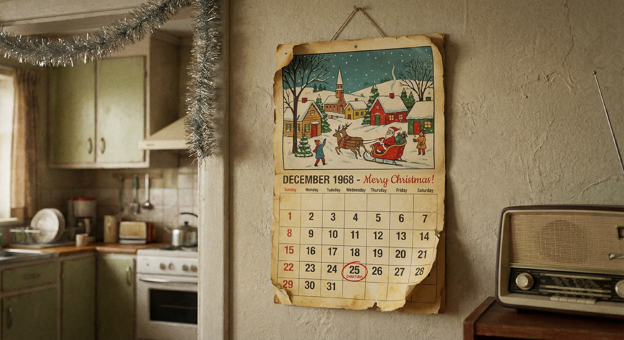
[AI generated image]

Slide 4
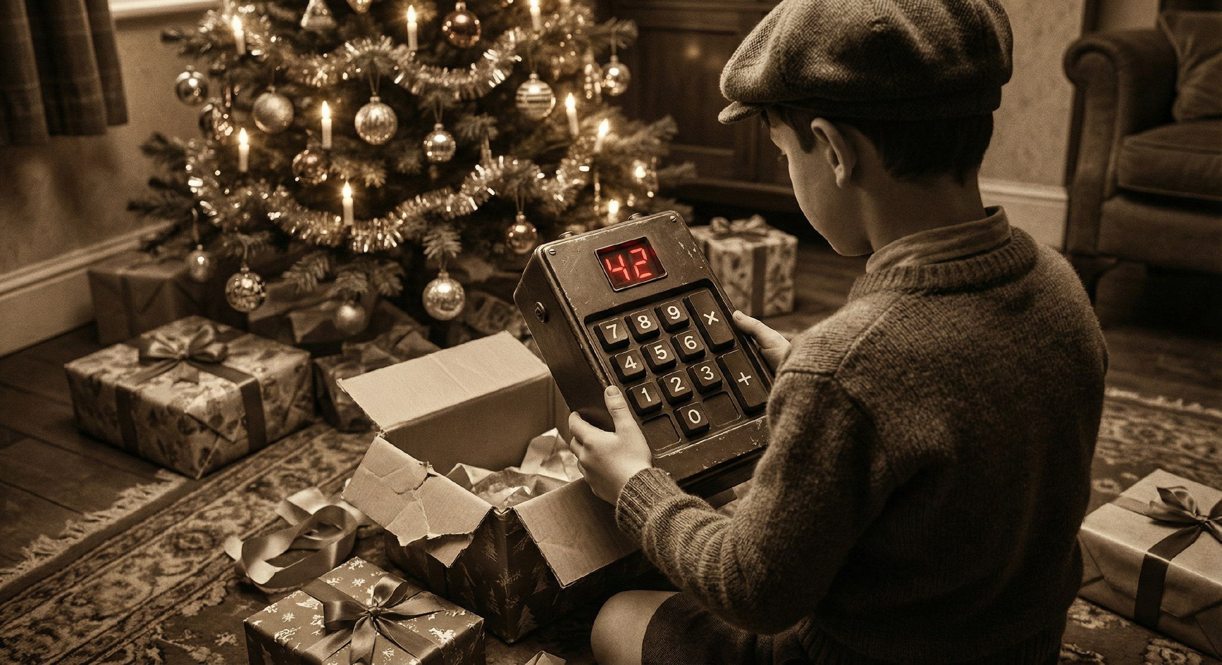
[AI generated image]

Slide 5

12
00
01
07
84
$$12×7=84$$
7
8
9
+
4
5
6
×
1
2
3
=
0

Slide 6


00
01
12
01
12
44
$$12×7=84$$
$12×12=44$ ???
7
8
9
+
4
5
6
×
1
2
3
=
0

Slide 7



Slide 9
lazy

Slide 10


$$28×23=544$$
lazy
lazy
$$28×23\overset{ }{=}44$$

Slide 11
1234

Slide 12
-1200
1234

Slide 13
-1200
1234
= 1234 - 1200

Slide 14
[AI generated image]

Slide 15
00
31
7
8
9
+
−7
24
4
5
6
×
−7
17
4 weeks-ish
−7
1
2
3
=
10
−7
0
3

Slide 16
00
03
31
09
93
24
31
7
8
9
+
+ 93
−7
24
4
5
6
×
−7
17
4 weeks-ish
−7
1
2
3
3
=
10
−7
0
3

Slide 17
24
09
93
17
31
7
8
9
+
+ 93
−7
24
4
5
6
×
+ 93
−7
17
4 weeks-ish
−7
1
2
3
=
10
−7
0
3

Slide 18
17
09
93
10
31
7
8
9
+
+ 93
−7
24
4
5
6
×
+ 93
−7
17
4 weeks-ish
+ 93
−7
1
2
3
=
10
−7
0
3

Slide 19
10
09
93
03
31
7
8
9
+
+ 93
−7
24
4
5
6
×
+ 93
−7
17
4 weeks-ish
+ 93
−7
1
2
3
=
10
+ 93
−7
0
3

Slide 20
???
lazy

Slide 21
lazy

Slide 22
lazy

Slide 23






…
lazy
lazy
$$94\overset{ }{=}−6$$
lazy
$$95\overset{ }{=}−5$$
lazy
$$96\overset{ }{=}−4$$
lazy
$$97\overset{ }{=}−3$$
lazy
$$98\overset{ }{=}−2$$
lazy
$$99\overset{ }{=}−1$$
…

Slide 24








…
lazy
lazy
$$94\overset{ }{=}−6$$
lazy
$$95\overset{ }{=}−5$$
lazy
$$96\overset{ }{=}−4$$
lazy
$$97\overset{ }{=}−3$$
lazy
$$98\overset{ }{=}−2$$
lazy
$$99\overset{ }{=}−1$$
…

Slide 25



Slide 26





lazy
$$a\overset{ }{=}b$$
$$⇔$$
$$a=b+k×100$$
integers modulo 100, or mod 100
$−1≡99$ ($\text{mod} 100$)

Slide 27
…
1
2
3
4
5
6
…
96
97
98
99
0
1

Slide 28
1
1
0
2
99
3
98
4
“ring”
97
5
…
…
96
6

Slide 29
1
0
2
-1
3
-2
4
“ring”
-3
5
…
-4
6

Slide 30

-1
0
1
-2
2
-3
3
-4
4
5
6

Slide 31
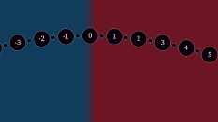
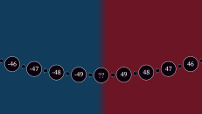

Slide 32
-45
45
-46
46
-47
47
-48
-49
49
48
??

Slide 33
…
-45
45
-46
46
-47
47
-48
48
-49
49
??

Slide 34
…
-45
45
-46
46
-47
47
-48
48
-49
49
??
-50

Slide 35
00 | 01 | 02 | 03 | 04 | 05 | 06 | 07 | 08 | 09
10 | 11 | 12 | 13 | 14 | 15 | 16 | 17 | 18 | 19
20 | 21 | 22 | 23 | 24 | 25 | 26 | 27 | 28 | 29
30 | 31 | 32 | 33 | 34 | 35 | 36 | 37 | 38 | 39
40 | 41 | 42 | 43 | 44 | 45 | 46 | 47 | 48 | 49
50 | 51 | 52 | 53 | 54 | 55 | 56 | 57 | 58 | 59
60 | 61 | 62 | 63 | 64 | 65 | 66 | 67 | 68 | 69
70 | 71 | 72 | 73 | 74 | 75 | 76 | 77 | 78 | 79
80 | 81 | 82 | 83 | 84 | 85 | 86 | 87 | 88 | 89
90 | 91 | 92 | 93 | 94 | 95 | 96 | 97 | 98 | 99
}
+
}
−

Slide 36
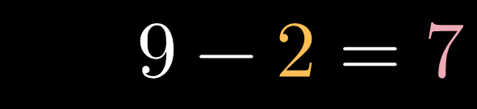


$9−4=5$
} ⇒
$$99−42=57$$
$9−2=7$

Slide 37
01011010
0
1
=
+
×

Slide 38
Name | Calculator
0 | 00
1 | 01
2 | 02
3 | 03
⋮ | ⋮
49 | 49
-50 | 50
-49 | 51
-48 | 52
⋮ | ⋮
-3 | 97
-2 | 98
-1 | 99
Name | Name | 8-bit CPU
0 | 0 | 00000000
1 | 1 | 00000001
2 | 2 | 00000010
3 | 3 | 00000011
⋮ | ⋮ | ⋮
127 | 127 | 01111111
128 | -128 | 10000000
129 | -127 | 10000001
130 | -126 | 10000010
⋮ | ⋮ | ⋮
253 | -3 | 11111101
254 | -2 | 11111110
255 | -1 | 11111111

Slide 39
Name | Calculator
0 | 00
1 | 01
2 | 02
3 | 03
⋮ | ⋮
49 | 49
-50 | 50
-49 | 51
-48 | 52
⋮ | ⋮
-3 | 97
-2 | 98
-1 | 99
Name | Name | 8-bit CPU
0 | 0 | 00000000
1 | 1 | 00000001
2 | 2 | 00000010
3 | 3 | 00000011
⋮ | ⋮ | ⋮
127 | 127 | 01111111
128 | -128 | 10000000
129 | -127 | 10000001
130 | -126 | 10000010
⋮ | ⋮ | ⋮
253 | -3 | 11111101
254 | -2 | 11111110
255 | -1 | 11111111

Slide 40
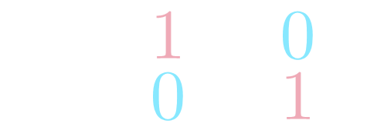

$$\begin{aligned}1−1=0 \\ 1−0=1 \end{aligned}$$
$$\begin{aligned}&11111111 \\ − &10110110 \\ =&01001001\end{aligned}$$

Slide 41
Two’s Complement.

Slide 42
96
97
98
99
0
1
1
2
3
4
5
6

Slide 43
…
-45
45
-46
46
-47
47
-48
48
-49
49
??
??

Slide 44
45
46
47
48
49
??
??
-49
-48
-47
-46
-45

Slide 45
-1
0
1
-2
2
-3
3
-4
4
-5
5
-6
6
-7
7
-8
8
-9
9
-10
10
-11
11
-12
12
-13
13
-14
14
-15
15
-16
16
-17
17
-18
18
-19
19
-20
20
-21
21
-22
22
-23
23
-24
24
-25
25
-26
26
-27
27
-28
28
-29
29
-30
30
-31
31
-32
32
-33
33
-34
34
-35
35
-36
36
-37
37
-38
38
-39
39
-40
40
-41
41
-42
42
-43
43
-44
44
-45
45
-46
46
-47
47
-48
-49
49
48
-50

Slide 46
-4
-3
-2
-1
0
1
2
3
4
-6
-5
5
6
-8
-7
7
8
-10
-9
9
10
-12
-11
11
12
-13
13
-14
14
-15
15
-16
16
-17
17
-18
18
-19
19
-20
20
-21
21
-22
22
-23
23
-24
24
-25
25
-26
26
-27
27
-28
28
-29
29
-30
30
-31
31
-32
32
-33
33
-34
34
-35
35
-36
36
-37
37
-38
-39
39
38
-40
-41
41
40
-42
-43
43
42
-44
-45
-46
46
45
44
-47
-48
-49
-50
49
48
47

